Slide 1

Smart Notepad & Priority Todo List
A C-Based Task Management System
Presented by -
Rajesh Biswas
Sajeeb Debnath
Presented to -
Md Samsuddoha
Assistant Professor
Department of computer science and engineering,
University of Barisal.

Slide 2
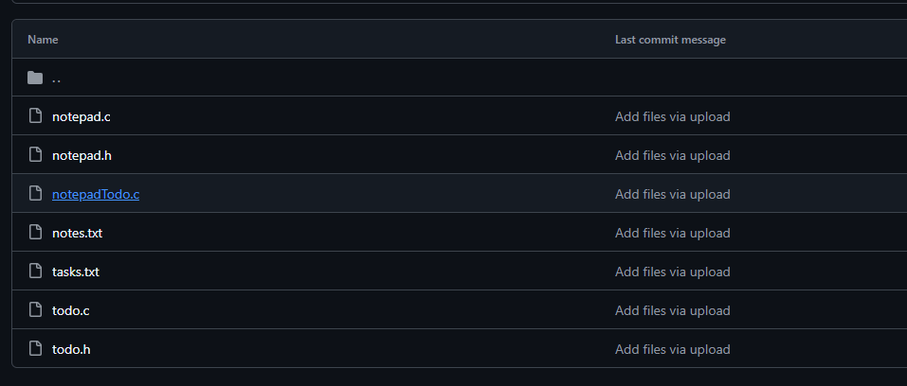
Introduction
This is a C-Based Notepad & Task Management System
• Console-based productivity tool
• Combines notepad + priority Todo list
• Built in C using data structures
Presented by
Rajesh & Sajeeb

Slide 3
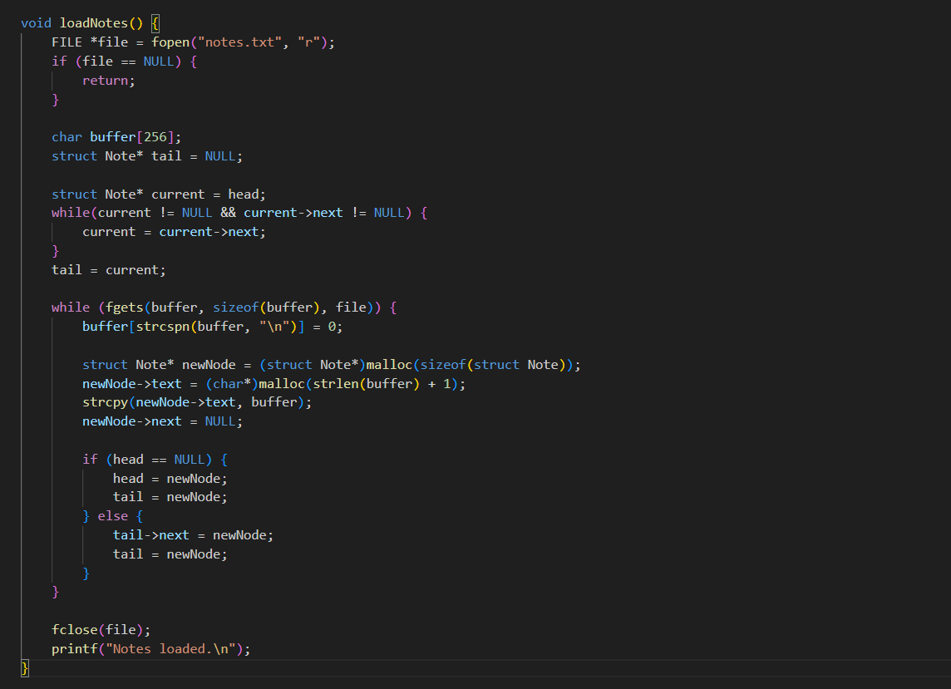
Why This Project?
• Real-world usability
• Practice Linked Lists & Heaps
• File Management in C
Presented by
Rajesh & Sajeeb

Slide 4
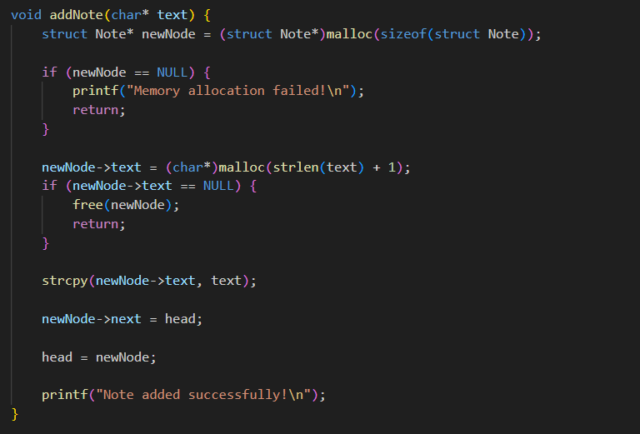
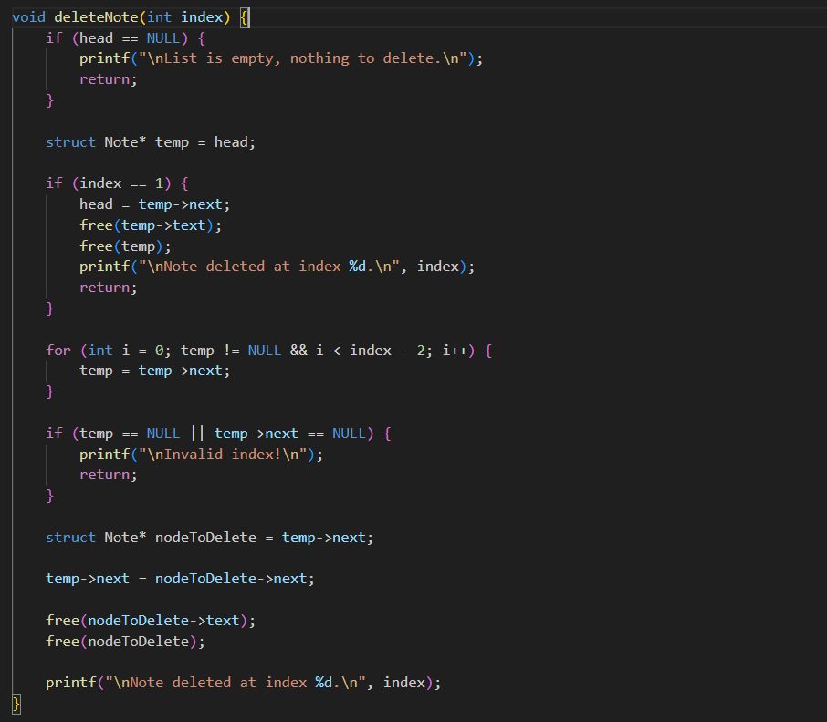
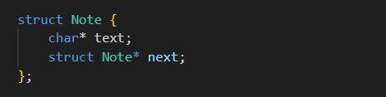
Data Structure: Notepad
• Linked List
• Dynamic memory usage
• Fast insertion & deletion
Presented by
Rajesh & Sajeeb

Slide 5
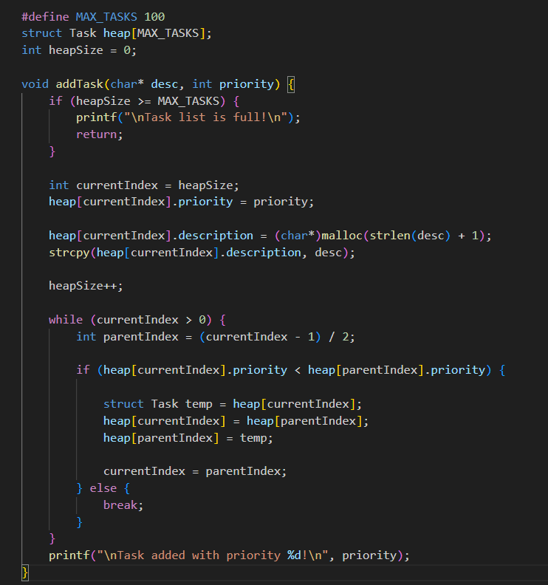
Data Structure: Todo List
• Min-Heap / Priority Queue
• O(1) highest priority access
• O(log n) insert/delete
Presented by
Rajesh & Sajeeb

Slide 6
Conclusion -
• Demonstrates power of C
• Efficient use of data structures
• Practical productivity system
Presented by
Rajesh & Sajeeb

